Slide 1
Coursera Capstone Project
Coursera IBM Data Science Certification
Geesala Vijay Kumar
7th July,2020

Slide 2
Report Content
1 Introduction Section:
Discussion of the "backgrounds situation" leading to the problem at hand:
Problem to be resolved
Audience for this project.
2 Data Section:
Data of Current Situation (current residence place)
Data required to resolve the problem
Data sources and data manipulation
3 Methodology section:
Process steps and strategy to resolve the problem
Data Science Methods, machine learing, mapping tools and exploratory data analysis.
4 Results section:
Discussion of the results and how they help to take a decision.
5 Discussion section:
Elaboration and discussion on any observations and/or recommendations for improvement.
6 Conclusion section:
Decisions taken and Report Conclusion.

Slide 3
1. Introduction Section:
Discussion of the business problem and the audience who would be interested in this project.
1.1 Scenario and Background
I am a data scientist currently residing in Downtown Singapore. I currently live within walking distance to Downtown "Telok Ayer MRT metro station" therefore I have access to good public transportation to work. Likewise, I enjoy many ammenities in the neighborhood , such as international cousine restaurants, cafes, food shops and entertainment. I have been offered a great opportunity to work in Manhattan, NY. Although, I am very excited about it, I am a bit stress toward the process to secure a comparable place to live in Manhattan. Therefore, I decided to apply the learned skills during the Coursera course to explore ways to make sure my decision is factual and rewarding. Of course, there are alternatives to achieve the answer using available Google and Social media tools, but it rewarding doing it myself with learned tools.
1.2 Problem to be resolved
The challenge to resolve is being able to find a rental apartment unit in Manhattan NY that offers similar characteristics and benefits to my current situation. Therefore, in order to set a basis for comparison, I want to find a renta unit subject to the following conditions:
Apartment with min 2 bedrooms with monthly rent not to exceed US$7000/month
Unit located within walking distance (<=1.0 mile, 1.6 km) from a subway metro station in Manhattan
Area with ammenities and venues similar to the ones described for current location ( See item 2.1)
1.3 Interested Audience
I believe this is a relevant project for a person or entity considering moving to a major city in Europe, US or Asia, since the approach and methodologies used here are applicable in all cases. The use of FourSquare data and mapping techniques combined with data analysis will help resolve the key questions arisen. Lastly, this project is a good practical case toward the development of Data Science skills.

Slide 4
2. Data Section:
Description of the data and its sources that will be used to solve the problem
2.1 Data of Current Situation
I Currently reside in the neighborhood of 'Mccallum Street' in Downtonw Singapore. I use Foursquare to identify the venues around the area of residence which are then shown in the Singapore map shown in methodology and execution in section 3.0 . It serves as a reference for comparison with the desired future location in Manhattan NY
2.2 Data Required to resolve the problem
In order to make a good choice of a similar apartment in Manhattan NY, the following data is required: List/Information on neighborhoods form Manhattan with their Geodata ( latitud and longitud. List/Information about the subway metro stations in Manhattan with geodata. Listed apartments for rent in Manhattan area with descriptions ( how many beds, price, location, address) Venues and ammenities in the Manhattan neighborhoods (e.g. top 10) 2.3 sources and manipulation The list of Manhattan neigbhorhood is worked out during LAb exercise during the course. A csv file was created which will be read in order to create a dataframe and its mapping. The csv file 'mh_neigh_data.csv' has the following below data structure. The file will be directly read to the Jupiter Notebook for convenience and space savings. The clustering of neighborhoods and mapping will be shown however. An algorythm was used to determine the geodata from Nominatim . The actual algorythm coding may be shown in 'markdown' mode becasues it takes time to run.

Slide 5
3. Methodology section:
This section represents the main component of the report where the data is gathered, prepared for analysis. The tools described are used here and the Notebook cells indicates the execution of steps.
The analysis and the strategy:
The strategy is based on mapping the above described data in section 2.0, in order to facilitate the choice of at least two candidate places for rent. The choice is made based on the demands imposed: location near a subway, rental price and similar venues to Singaapproach and maps with popups labels allow quick identification of location, price and feature, thus making the selection very easy.pore. This visual

Slide 6
4.Execution and Results

Slide 7
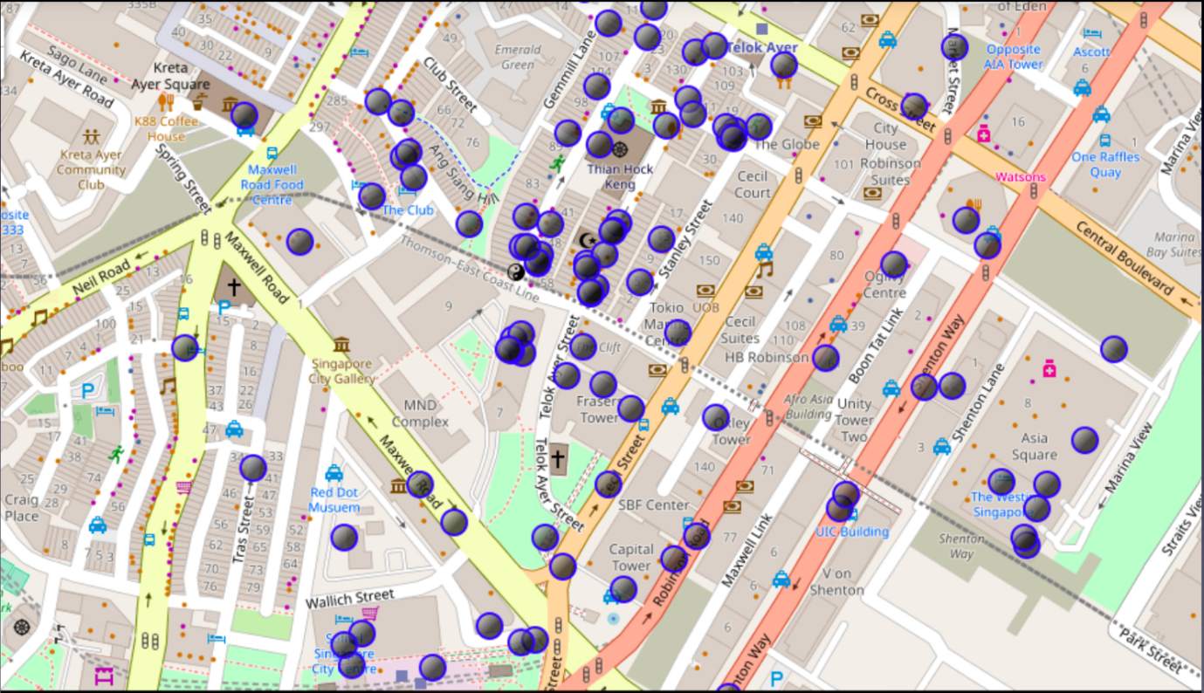
Current Residence Neighbourhood in Singapore

Slide 8
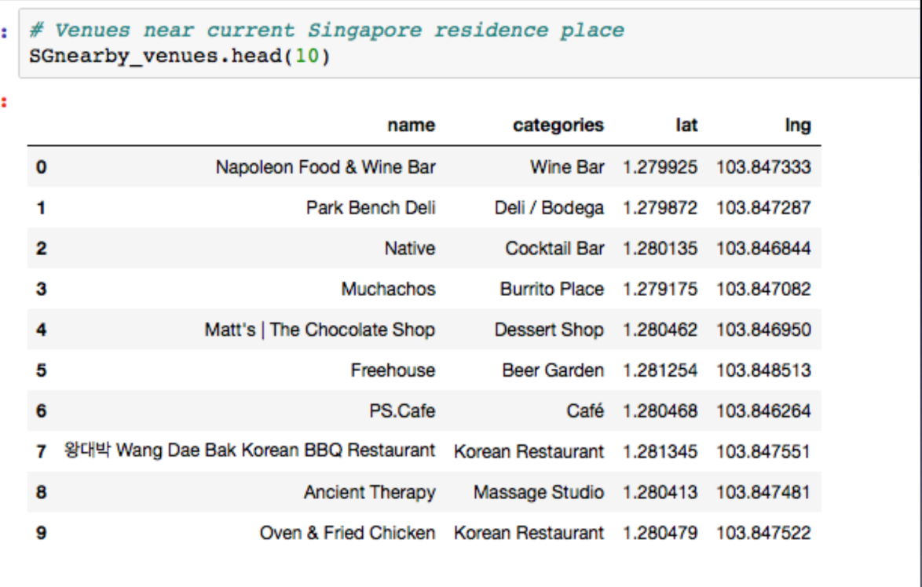
Venues Around Neighbourhood in

Slide 9
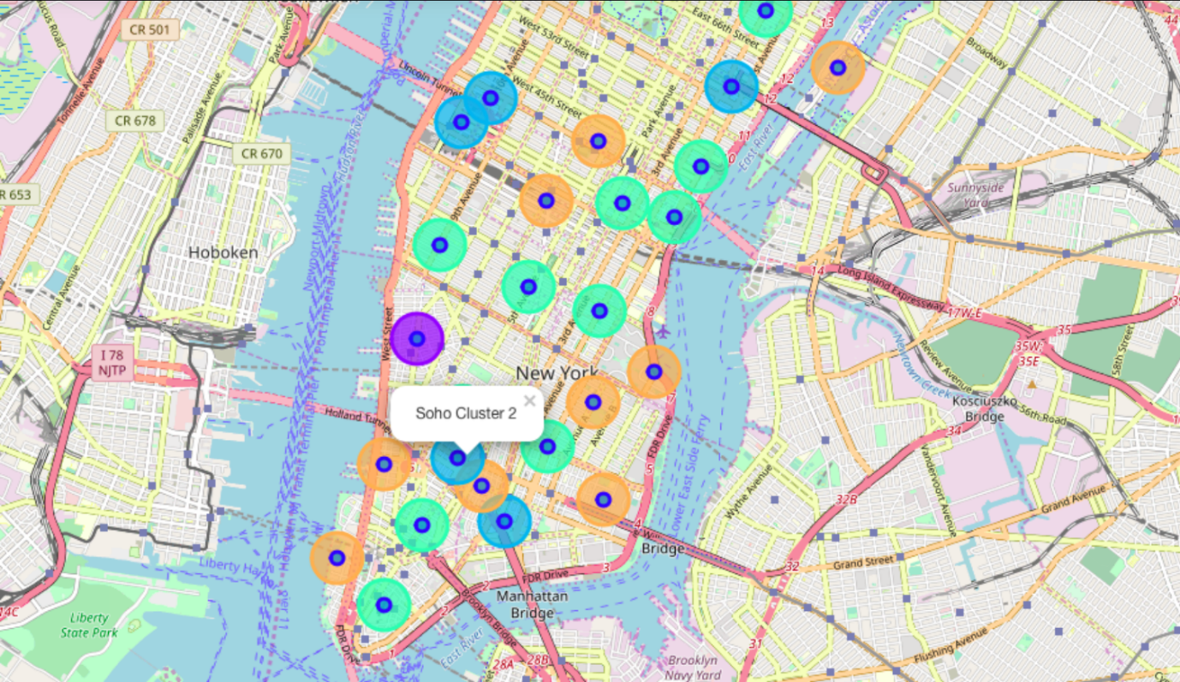
Manhattan Map – Neighbourhoods and clusters of venue

Slide 10
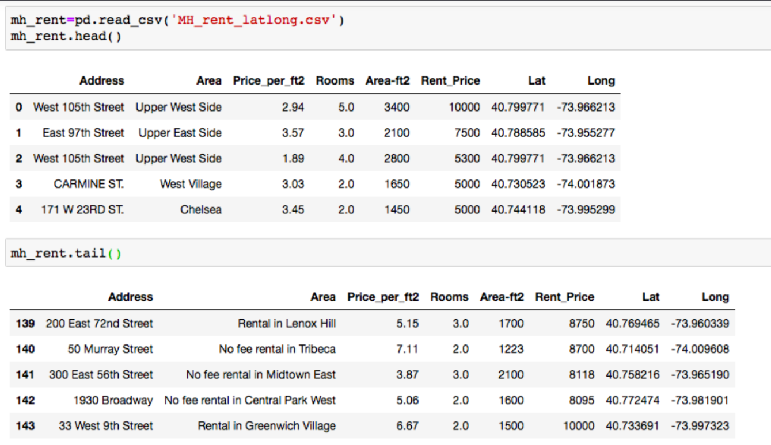
GeoData Manhattan apts for Rent

Slide 11
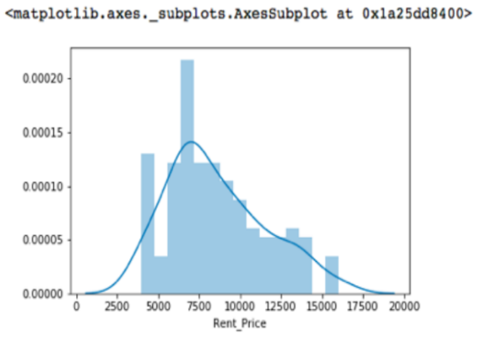
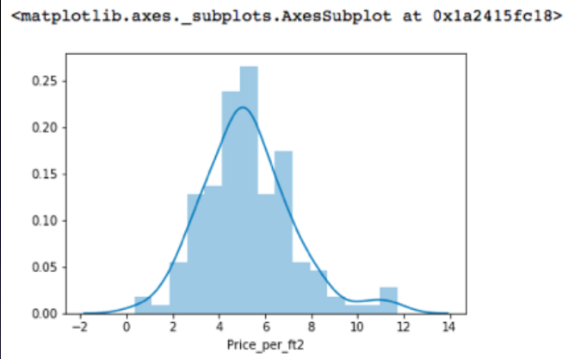
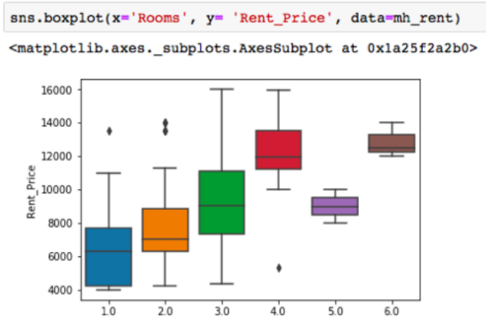
Rental Price Statistics MH Apartments

Slide 12
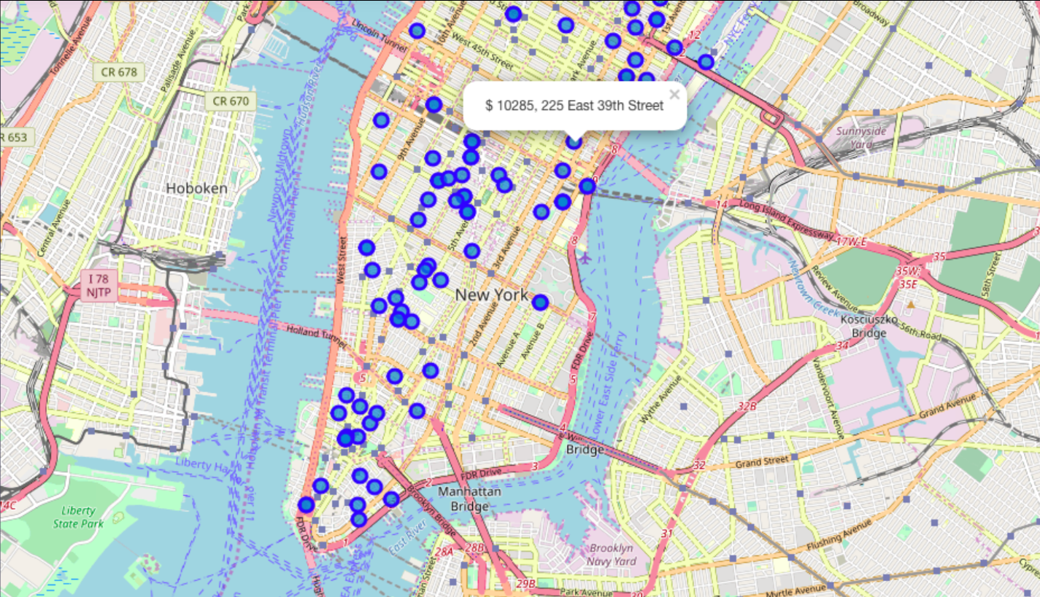
Apartments For Rent in MH

Slide 13
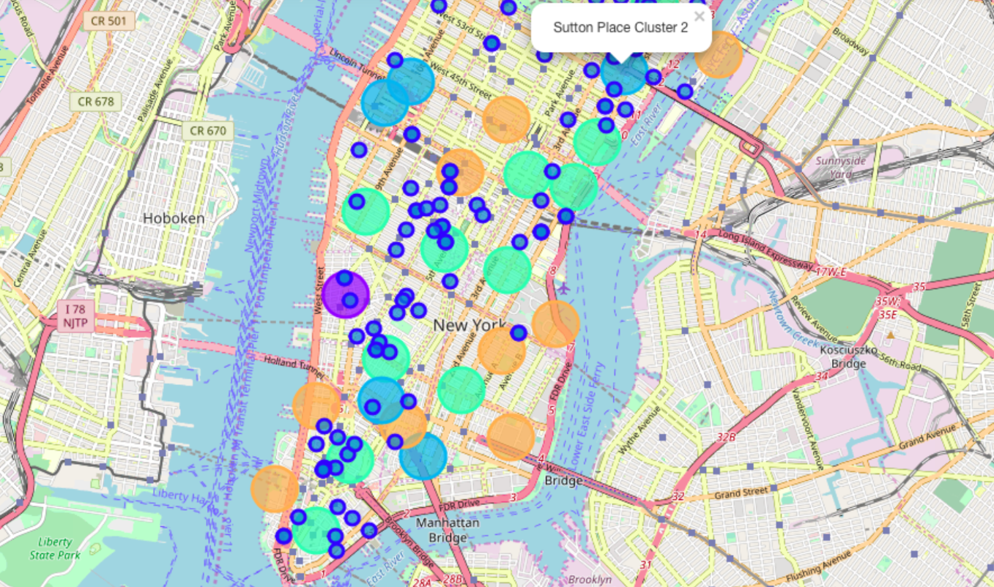
MH apts for rent with venue clusters

Slide 14
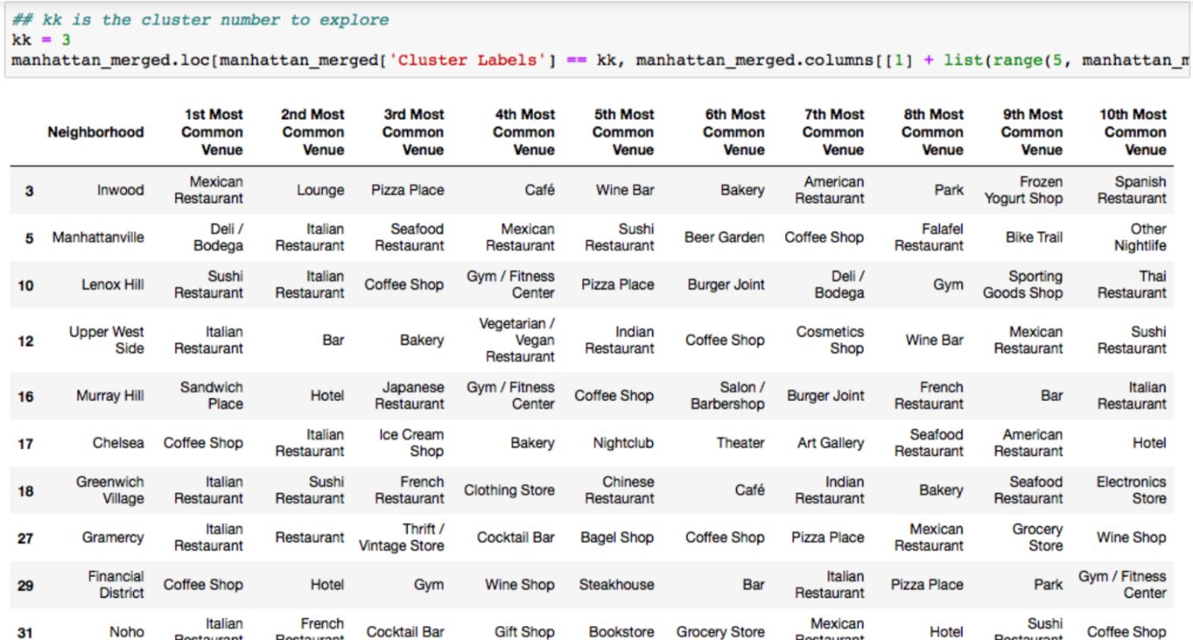
Venues of Cluster 3

Slide 15
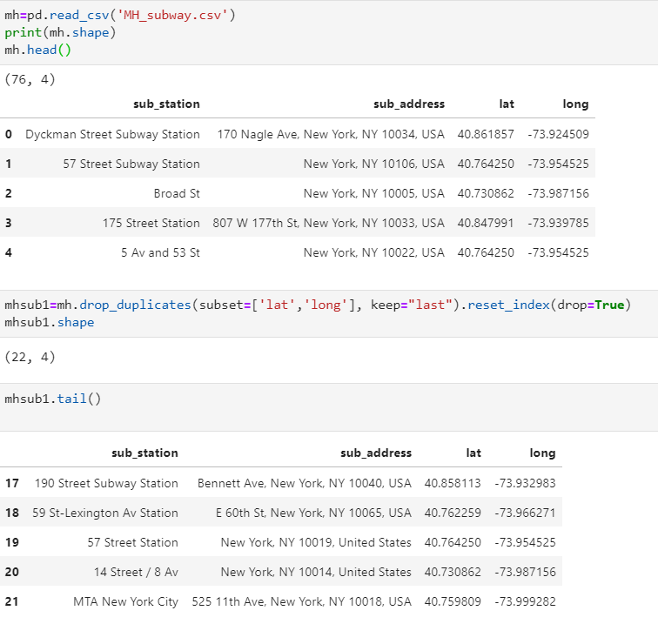
Manhattan subway stations geodata

Slide 16
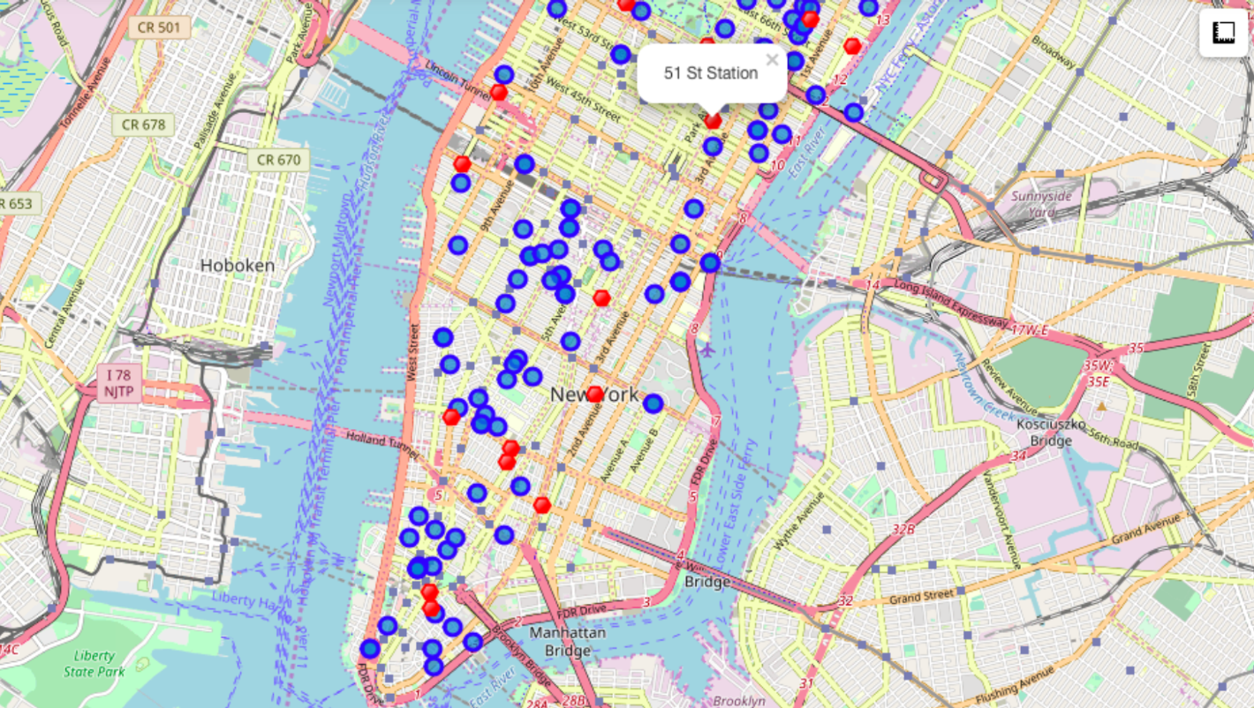
Apts for rent (blue) and subway stations(red)

Slide 17
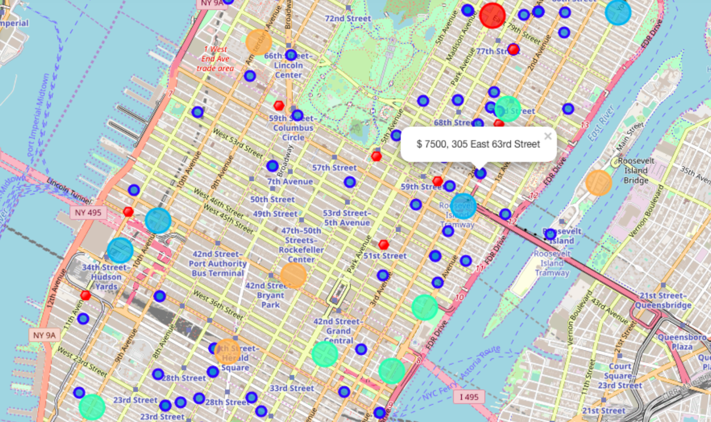
Selected Apartment! The one consolidated map shows all information for decision. Apartments address, price, neighourhood, cluster of venues and subway station nearby Blue dots=apts , Red dots=Subway station, Bubbles=Cluster of Venues

Slide 18
Apartment Selection
Using the "one map" above, I was able to explore all possibilities since the popups provide the information needed for a good decision.
Apartment 1 rent cost is US7500 slightly above the US7000 budget. Apt 1 is located 400 meters from subway station at 59th Street and work place (Park Ave and 53rd) is another 600 meters way. I can walk to work place and use subway for other places around. Venues for this apt are as of Cluster 2 and it is located in a fine district in the East side of Manhattan.
Apartment 2 rent cost is US6935, just under the US7000 budget. Apt 2 is located 60 meters from subway station at Fulton Street, but I will have to ride the subway daily to work, possibly 40-60 min ride. Venues for this apt are as of Cluster 3. Based on current Singapore venues, I feel that Cluster 2 type of venues is a closer resemblance to my current place. That means that APARTMENT 1 is a better choice since the extra monthly rent is worth the conveniences it provides.

Slide 19
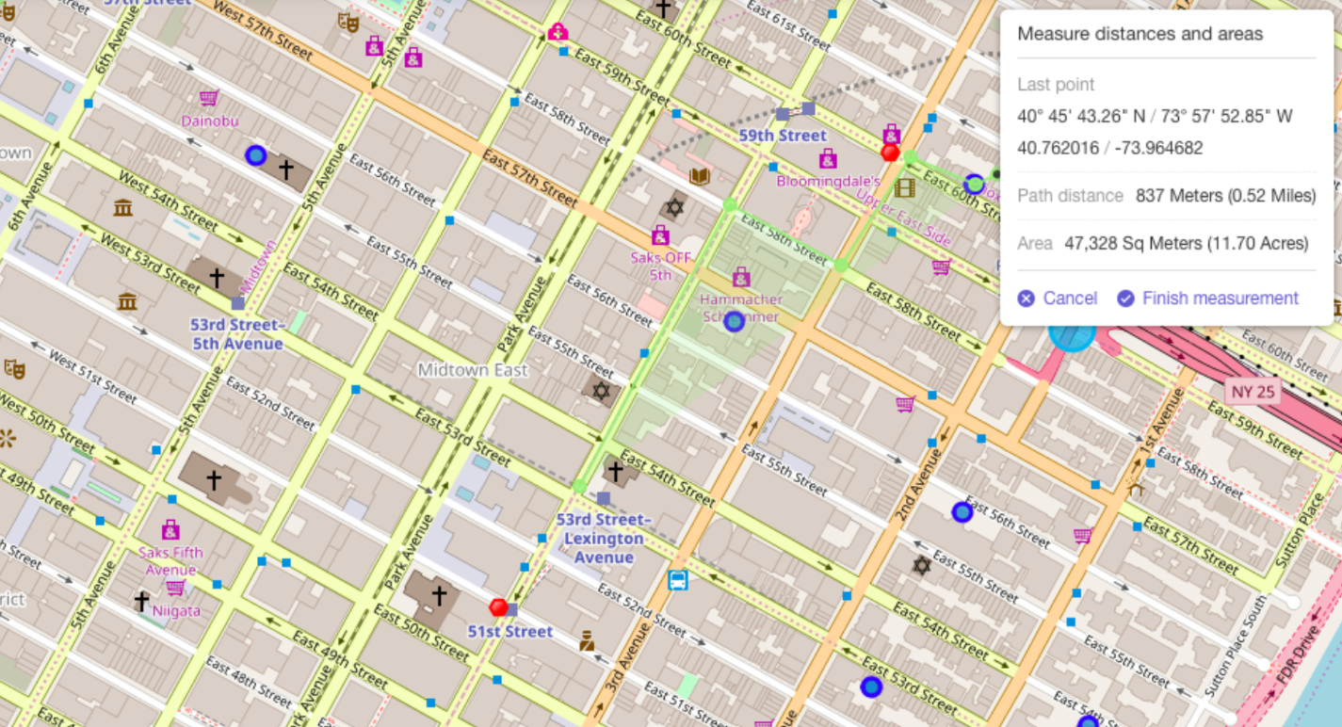
I will walk to work Walk from home to work is less then 1km!

Slide 20
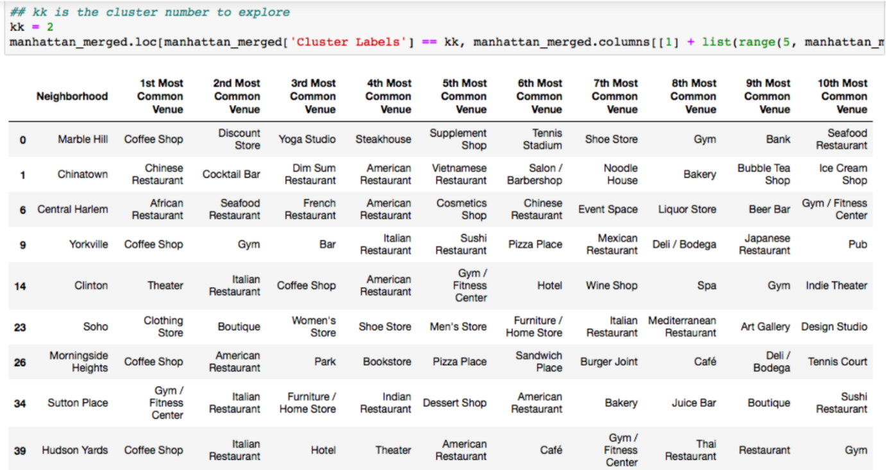
Venus in Cluster 2 near future home

Slide 21
5 DISCUSSION
In general, I am positively impressed with the overall organization, content and lab works presented during the Coursera IBM Certification Course I feel this Capstone project presented me a great opportunity to practice and apply the Data Science tools and methodologies learned. I have created a good project that I can present as an example to show my potential. I feel I have acquired a good starting point to become a professional Data Scientist and I will continue exploring to creating examples of practical cases.
6. CONCLUSIONS
I feel rewarded with the efforts, time and money spent. I believe this course with all the topics covered is well worthy of appreciation. This project has shown me a practical application to resolve a real situation that has impacting personal and financial impact using Data Science tools. The mapping with Folium is a very powerful technique to consolidate information and make the analysis and decision thoroughly and with confidence. I would recommend for use in similar situations. One must keep abreast of new tools for DS that continue to appear for application in several business fields.

